Slide 1
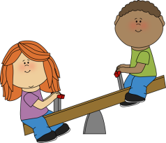

Bright Sparks Preschool
"We grow together"

